Slide 1

JavaScript Objects
Aruna S
Department of
Computer Science and Engineering

Slide 2

JAVASCRIPT OBJECTS
Basic Object Oriented Concepts
S. Aruna
Department of Computer Science and Engineering

Slide 3
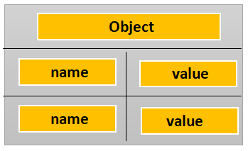
JAVASCRIPT OBJECTS
Basic Object Oriented Concepts
An object in JavaScript is a reference data type.
An object can be compared to any real world entities.
An object is an unordered list of properties consisting of a name (always a string) and a value. When the value of a property is a function, it is called a method.
Fig 1:Object Structure
Var object1= new Object(); Fig 2:Object Reference
Var object2 = object1;
Variable Object
MEMORY
object1
Object
object2

Slide 4
JAVASCRIPT OBJECTS
Object Properties
Every object has associated properties with it .
Properties refer to the collection of values which are associated with the JavaScript object and it is an unordered collection.
Object properties are defined as a simple association between name and value.
Properties defines the characteristics of the object.
JavaScript provides the feature to add, delete and modify the properties. Properties are denoted by name:value pairs.
Syntax:
objectName.property
objectName["property"]
objectName[expression]

Slide 5
JAVASCRIPT OBJECTS
Object Methods
JavaScript methods are actions that can be performed on objects.
A JavaScript method is a property containing a function definition.
Methods are functions stored as object properties.
Access an object method with the following syntax:
objectName.methodName()
Property will execute (as a function) when it is invoked with ().
Accessing without () returns the function definition
Adding a method is similar to adding a property to an object

Slide 6
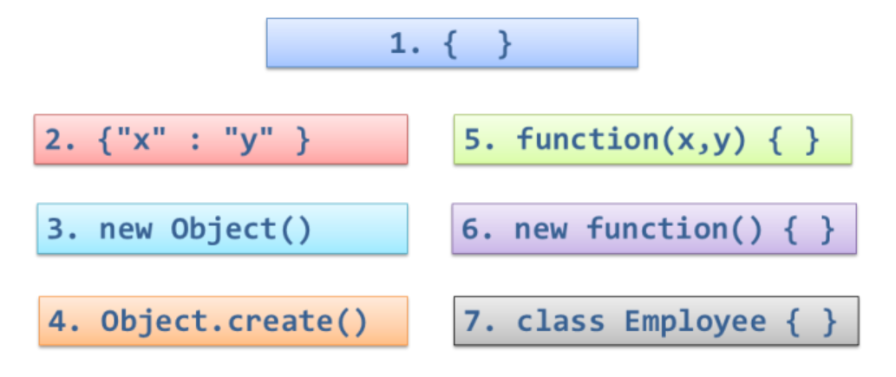
JAVASCRIPT OBJECTS
Different ways of creating objects in JavaScript

Slide 7
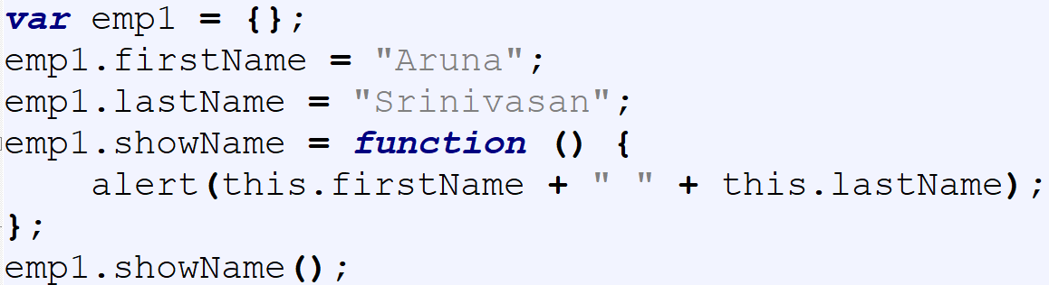
JAVASCRIPT OBJECTS
Object Literals using {}
Create an object using object literal or object initializer syntax. {}
The empty curly brackets indicate that a new object has been created.
Once created you can add members to the object using object-property syntax

Slide 8
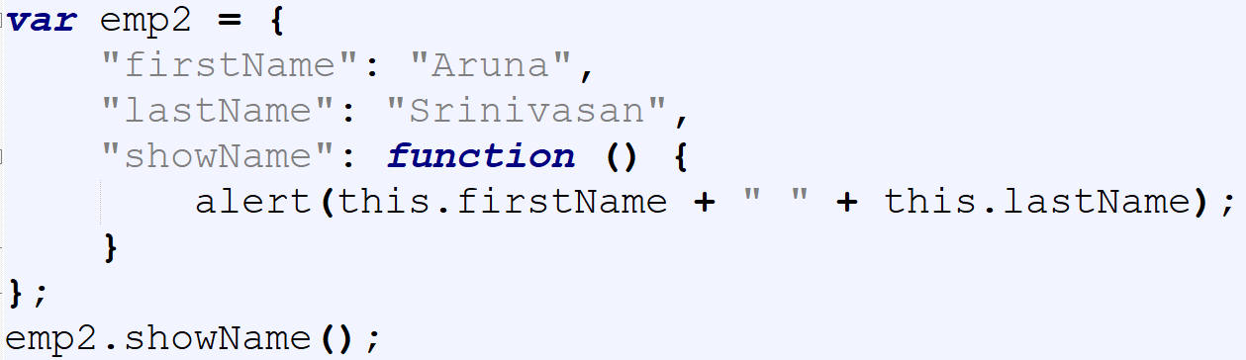
JAVASCRIPT OBJECTS
Object Literals using {key : value}
A variant of object literal syntax
Specifies object members and their values inside the curly brackets as key-value pairs
A member and its value are delimited using colon (:) character.

Slide 9
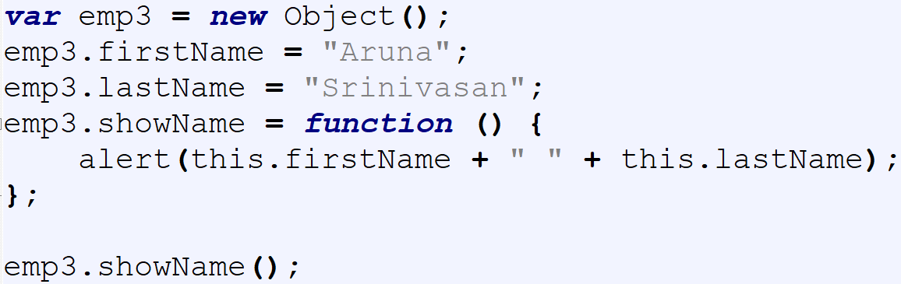
JAVASCRIPT OBJECTS
Creating an object using new Object()
A readable and more verbose way of creating an object.
The new keyword is used to create a new object based on inbuilt Global Object.
Member and then added to the newly create object

Slide 10
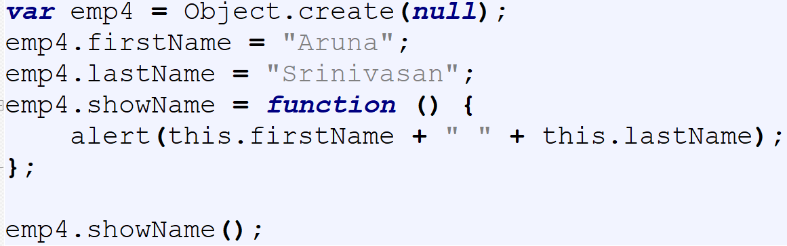
JAVASCRIPT OBJECTS
Creating an object using Object.create()
The create() method creates a new object based on the prototype of the supplied object.
This syntax is handy if you have an object with default values and wish to create multiple objects based on that prototype.

Slide 11
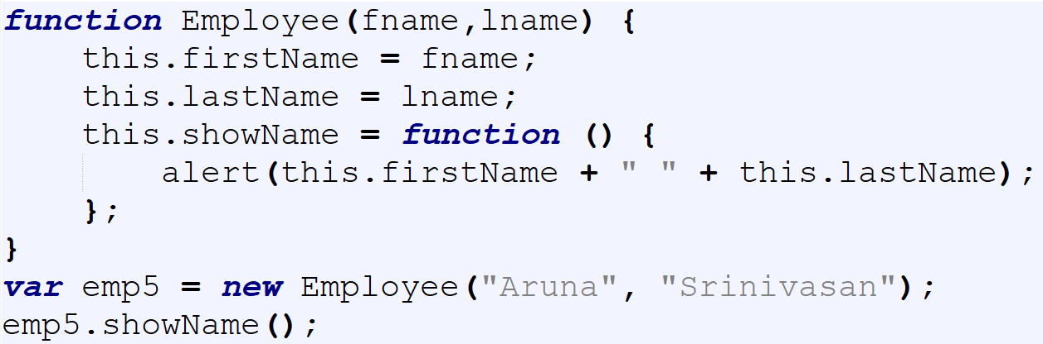
JAVASCRIPT OBJECTS
Creating an object using function Constructor
JavaScript functions are objects themselves. It can be called as a Constructor Function.
Once the function constructor is created you create object of that function using new keyword.
The function name uses camel case convention

Slide 12
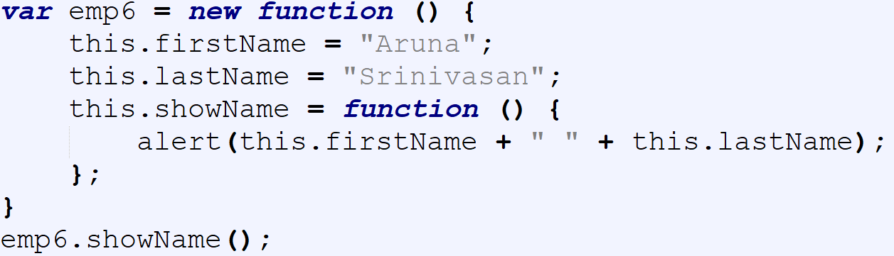
JAVASCRIPT OBJECTS
Creating an object using anonymous function
Two steps are performed here
Firstly, it creates an anonymous constructor function
secondly, it calls new on it to create its object.

Slide 13
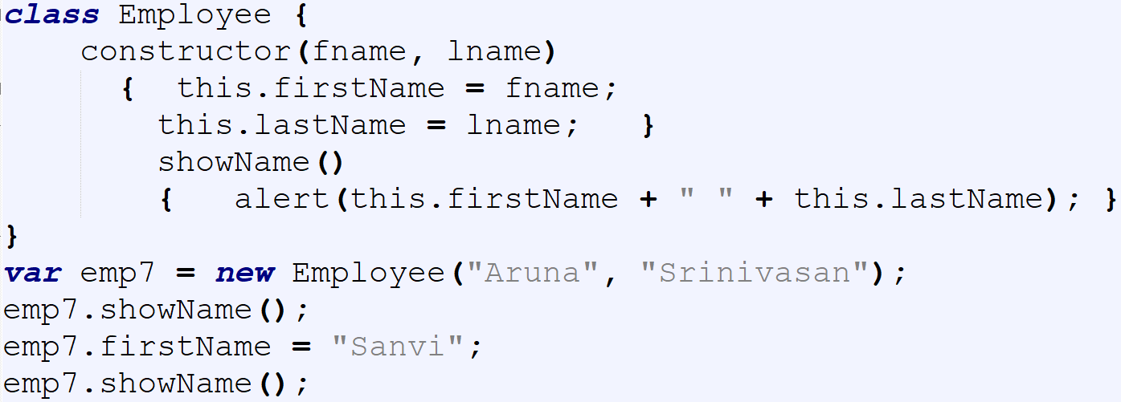
JAVASCRIPT OBJECTS
Creating an object using EcmaScript 6 Class Keyword
Class is defined .
Then the objects of the class are created.
It still uses the prototype based approach of creating objects

Slide 14
THANK YOU
Aruna S
Department of
Computer Science and Engineering
arunas@pes.edu

